Slide 1
L10 – Metrics and evaluation
FIT2101: Software Engineering Process and Management
S2 2020

Slide 2
In this lecture…
Metrics and measurement
Size metrics
Function metrics
Metrics and targets
perverse incentives

Slide 3

Measuring your work
If we want to be able to produce high-quality software efficiently, we need to be able to measure both the quality of our work and the efficiency of our process.

Slide 4
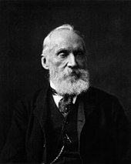
Why do we measure?
When you can measure what you are speaking about, and express it in numbers, you know something about it;
but when you cannot measure it, when you cannot express it in numbers, your knowledge is of a meagre and unsatisfactory kind;
it may be the beginning of knowledge, but you have scarcely in your thoughts advanced to the stage of science, whatever the matter may be.
-- Baron William Thomson Kelvin

Slide 5
Why do we measure?
Ultimately, because we want to deliver high-quality software, on time, and on budget
So we need to know
how good our software is
when we are likely to deliver
how much we are spending on constructing the software
how much it is likely to cost to maintain and extend our software
We try to measure these things so that we can
control them better
predict them better
understand how well our project is progressing
target our resources most effectively
e.g. if we discover that a particular part of the code takes longer to modify, or is especially error-prone, perhaps we should refactor it
Notes:
If we find that a particular part of the code

Slide 6
What is a metric?
A metric is the outcome of measuring something
software product
development process
project
It is the result of applying a well-defined, repeatable process
can’t just make up a number and call it a metric
It is a quantitative measure
i.e. applying your measurement process gives you a number
It gives us information about something we care about
Notes:
You can of course invent your own metrics if your project or team require it. In this case, you’re still not just making up a number – you’re making up a process for computing a number.
It’s okay if that process includes estimation – in fact, it’s almost inevitable. Velocity is a well-known and very useful metric, and it’s based on story points, which are estimates of effort. Even if you use the more rigorously-defined function points, the process includes a step in which you have to estimate the complexity of various system components.

Slide 7
Useful metrics
In order to be useful, a metric must
be reasonably easy to compute
it’s best of all if you can automate it
be computable before it is needed
be strongly related to the thing you are trying to measure

Slide 8
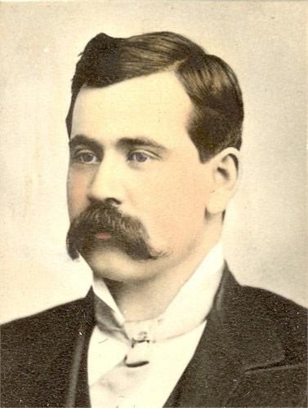
But…
Not everything that can be counted counts, and not everything that counts can be counted.
-- William Bruce Cameron
Notes:
This quote is often attributed to Albert Einstein, but actually seems to have been first uttered by sociologist William Bruce Cameron in his 1963 book Informal Sociology.

Slide 9
Choose your metrics well
Some things that we care about are hard to measure
such as product quality
we can count bugs found, but can only estimate how many remain
we can’t measure how satisfied our future customers will be
Sometimes the information that is easy to gather isn’t helpful
e.g. velocity is useful for tracking changes in productivity, but only if it is computed in a consistent way
comparing velocities between teams tells you nothing useful
It is a common mistake to collect information that is easy to collect, instead of the information that you need
this is called the “streetlight effect”: the tendency to look for your lost keys where the light is good, instead of where you dropped them
Notes:
Velocity is measured as story points per iteration, and story points themselves are estimated by each team. There is no reason to assume that different teams estimate stories in the same way. Velocity can’t be compared between teams because the value of a story point varies between teams, and will depend on factors including each team’s experience level with different technologies, work habits, preferences, known skills etc.

Slide 10
Metrics are not useful by themselves
We collect information about our system so that we can understand things about our process, product, and project
The numbers we collect are not meaningful unless we can interpret them
we need to understand the relationship between the information we collect and the aspects of the project that we are interested in
Notes:
If I tell you that your software has a “quality factor of 9.7”, does it help? No; the number only makes sense in context. (What does it measure?
If I tell you that we found more bugs this week than last week, does it help you understand what’s going on in the project? Not by itself – is there a reason to believe that more bugs are being inserted into the code (e.g. we’re working on something new or difficult, or we’ve been trying to increase velocity and standards are slipping?) Or are we getting better at finding existing bugs?

Slide 11
Metrics and process improvement
Before we can select a metric, we need to figure out what it is that we are interested in measuring
productivity?
quality?
cost?
We need to consider what aspects of that thing are going to have an effect we can measure easily
then all we need to do is figure out how to measure that visible effect

Slide 12
LOC, SLOC, KLOC
LOC stands for lines of code
also called SLOC, source lines of code
KLOC means 1000 LOC (K for kilo)
Not usually as simple as counting the number of lines in the file
do you count comments?
do you count blank lines?
what about statements that are spread out across multiple lines for readability?
But still very easy to compute
Also lets you work out other metrics that you might want to use
errors per KLOC
comments per KLOC
development cost per KLOC

Slide 13
LOC as a metric
We have established that LOC is easy to compute
also easy to automate
It is also quick enough to measure that you can get a result as soon as the code is written
Is it strongly related to the thing you’re trying to measure?
if you’re trying to measure the code size, then yes…
but why do you want to know the code size?
what does the size of a codebase tell you about it?
Notes:
Large code entities (classes, files, modules, functions) are a code smell, and a high LOC might indicate this. However, just because code is smelly doesn’t mean it’s not okay., or that it would be worthwhile to refactor it.

Slide 14
Problems with LOC
Each LOC counts the same, but not all lines of code are created equal
Python examples: mark = 76 grade = "F" if mark < 50 else "P" if mark < 60 else "C" if mark < 70 else "D" if mark < 80 else "HD"
LOC varies widely depending on language
different languages have different power, different libraries, more or less verbose syntax etc.
LOC will also vary depending on what the code is for
consider spike code vs. production code vs. unit test code
We don’t typically care about code size
we care about what it’s usually associated with: functionality!
so can we come up with a better estimator for functionality?

Slide 15
Function points
A metric that involves computing an estimate of functionality rather than just code size
The first function point metric was FPA (Function Point Analysis), developed at IBM by Alan Albrecht in 1979
you begin by identifying the functions of the system – inputs, outputs, queries, and accesses to internal and external files/data repositories
estimate the functional complexity for each function
add these estimates together, giving the Unadjusted Function Point count (UFP)
compute a Value Adjustment Factor (VAF) based on the importance to the system of fourteen different factors
Total FP = UFP * (0.65 + 0.01 * VAF)
There is an interest group called IFPUG (International FP Users Group) if you’re looking for more info about FPA
Notes:
The fourteen factors are:
Does the system require reliable backup and recovery?
Are data communications required?
Are there distributed processing functions?
Is performance critical?
Will the system run in an existing, heavily utilised operational environment?
Does the system require on-line data entry?
Does the on-line data entry require the input transaction to be built over multiple screens or operations?
Are the master files updated on-line?
Are the inputs, outputs, files or inquiries complex?
Is the internal processing complex?
Is the code designed to be reusable?
Are conversion and installation included in the design?
Is the system designed for multiple installations in different organizations?
Is the application designed to facilitate change and ease of use by the user?

Slide 16
Pros and cons of FPA
Advantage: FPA has been standardized by ISO/IEC
so there’s a body of people out there who know how to use it
Disadvantage: FPA was designed for business information systems and isn’t easily adaptable to other domains
FPA is computed based on requirements and so is independent of programming language
although there are estimates required at several stages
and it’s not especially easy to compute…
Big advantage: you don’t need the code
so companies can (and do!) use this and related metrics to estimate projects before development
need to have reasonably complete requirements to do this, so not a good fit for typical Agile projects

Slide 17
Story points
Story points in Agile development are similar in spirit to function points in FPA
but they are estimated, not derived from a repeatable process
so by our definition they are not a metric in themselves (estimation and measuring are not the same thing)
But you can definitely use story points to compute other metrics…
if story point estimation remains the same, then velocity is a metric (it measures team productivity per unit time)

Slide 18
Metrics and targets
Metrics are useful for finding out about your project, product, and process
But beware of using them as targets or KPIs
KPI: Key Performance Indicator, a measure of how well an individual or team is doing
essentially, your KPIs are the measures your boss uses to decide whether to tell you off or congratulate you
Goodhart’s Law: when a measure becomes a target, it ceases to be a good measure
Economists call this kind of situation a perverse incentive: a system of rewards that accidentally rewards people or organizations for doing bad things

Slide 19

The Cobra Effect
The story goes that in Delhi during the British Raj, the governor decided to reduce the population of cobras. They did this by offering a large bounty on cobra skins.
Some people responded to this by killing cobras, but others responded by farming them, since they could now get a guaranteed income by turning in the skins.
When the governor heard about this, he ended the bounty scheme… at which point the cobra farmers, not wanting to pay for the upkeep of now-worthless snakes, turned their cobras loose.
The net result was a large net increase in the number of cobras in Delhi.
Notes:
Something similar happened in Hanoi under the French – the occupying government offered a bounty for rat tails, but rats can survive (and breed) quite happily without a tail, producing more offspring for enterprising ratcatchers to catch.

Slide 20
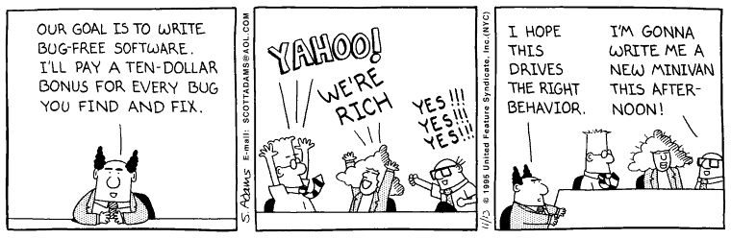
Perverse incentives in software development

Slide 21
Example: velocity
Suppose an established Agile team has a stable velocity of 57 story points per iteration
A senior manager, hoping to motivate the team to work harder, offers the team a bonus if they can improve their velocity over 65 story points per iteration
what do you think this will do to the team’s story estimations?
what do you think this will do to the team’s ability to predict future iterations?
Notes:
If the team is to be rewarded for implementing more story points, the natural thing to do is to inflate story point estimates. This change will cause instability in the velocity.

Slide 22
Accidental teamicide
Suppose a senior manager decides to reward high-performing individuals on the team
“Keep track of how many story points each person implements. At the end of the sprint, we will pay a bonus to the developer who has implemented the most story points.”
what will this do to team morale?
what will this do to the team’s ability to self-organize?
what will this do to the team’s ability to collaborate?
Notes:
“Involuntary teamslaughter”?

Slide 23
Summary
Measurement and metrics
Size metrics (LOC)
Function point analysis
Metrics and perverse incentives

Slide 24
Next lecture
Ethical and legal aspects of software development

